Slide 1
Controllable Switches
modified from CS231 slides
University of Illinois
Howard Huang

Slide 2
Controllable Switches
How can we make a “Machine” that can do complex things
Add and multiply really fast
Weather forecast, design of medicinal drugs
Speech recognition, Robotics, Artificial Intelligence...
Web browsers, internet communication protocols
Starting at (almost) the lowest level

Slide 3
The Modest Switch
All these capabilities are built from an extremely simple component:
A controllable switch
The usual Electrical switch we use every day
The electric switch we use turns current on and off
But we need to turn it on and off by hand
The result of turning the switch on?
The “top end” in the figure becomes
raised to a high voltage
Which makes the current flow through the bulb
The Controllable Switch
No hands
Voltage controls if the switch is on or off
High voltage at input: switch on
Otherwise it is off

Slide 4
Using the switch
Input
Output is high (voltage) if and only if the input is high
Output
Now we can make one circuit control another switch…
Neat!
This is getting boring..

Slide 5

Lets use them creatively
Input1
Output is high if both the inputs input1 AND input2 are high
If either of the inputs is low, the output is low.
Output
This is called an AND gate
Input2
Now, can you make an OR gate with switches?

Slide 6
OR Gate
Input1
Output
Input2
Output is low iff both inputs are low
i.e. Output is high if either of the inputs (or both) are high (input1 OR input2)

Slide 7


Basic Gates
There are three basic kinds of logic gates
Operation:
AND
of two inputs
OR of two inputs
NOT
(complement)
of one input
Logic gate:
A little circle on the output side means “not”
x' means “not x”
Two Questions:
How can we implement controllable switches?
What can we build with Gates? And How?

Slide 8
Logic gates

Slide 9
How to make controllable switches?
Use mechanical power
Use hydraulic pressure
Use electromechanical switches (electromagnet turns the switch on)
Current technology:
Semiconductor transistors
A transistor can be made to conduct electricity depending on the input on the 3rd input
CMOS “gates” (actually, switches)
We can now manufacture 60 billion transistors on a single silicon chip!
So, switches and Gates are not magic.
We believe they can be built

Slide 10
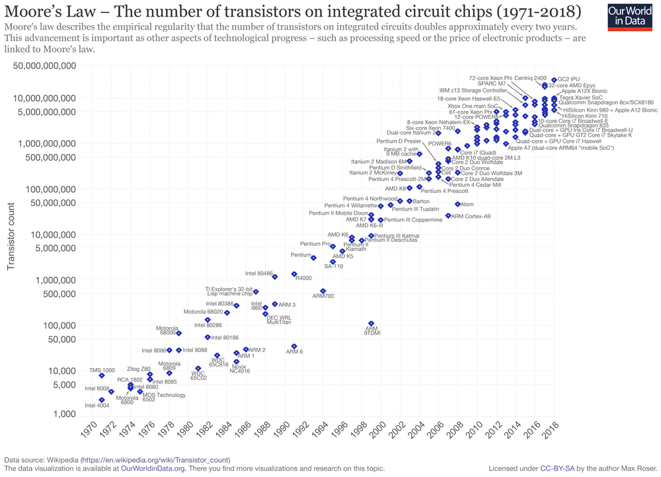

Slide 11
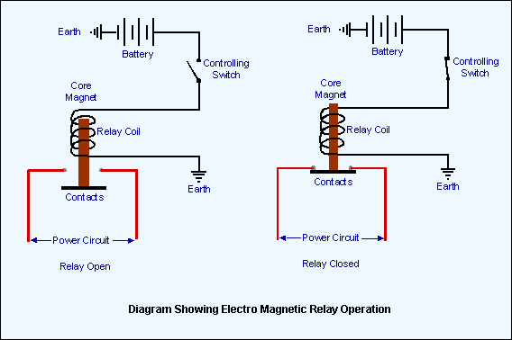
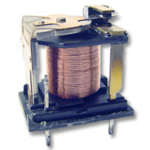
Electromechanical Switches
Closing the switch causes current to flow through the coil. Current in the coil creates a magnetic field.
Magnetic field attracts the iron armature. Armature moves, bringing the contacts together.
Power circuit is now “on”.
The device is a controllable switch.

Slide 12
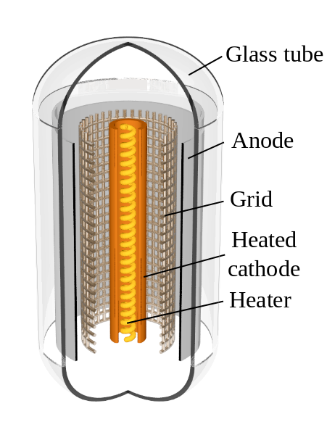
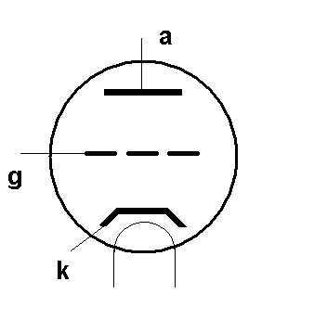
Vacuum Tube Switches
Electrons flow (thru a vacuum) from heated cathode (k) to anode (a).
Anode is at high positive voltage (+100 volts or more) and attracts electrons.
A negative voltage on the grid (g) repels the electrons and stops the flow.
A positive voltage on the grid attracts the electrons and lets electrons flow.
Voltage on the grid controls the current (k) to (a).
The device is a controllable switch.

Slide 13
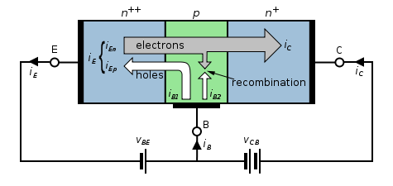

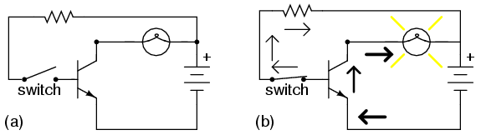
Transistor Switches
A small change in the voltage applied across the base (B) – emitter (E)
circuit greatly changes the current in the collector (C) – emitter circuit.
The device is a controllable switch.

Slide 14
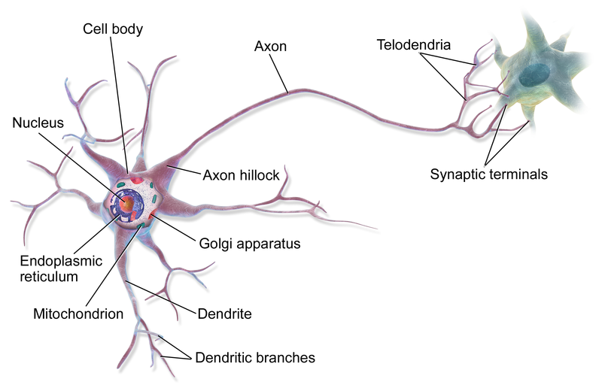
Brain Switches (Neurons)
Several other neurons connect to the dendrites of a neuron at its synapses.
If enough of them electrically stimulate the neuron, it fires, and sends an
electrical signal down its axon.
Its axon is connected to other neurons.
The device is a controllable switch (in this very simplified view.)

Slide 15
A little bit about technology
Two properties of Switches and Gates:
Size
Switching and propagation delay
Smaller the size, smaller the propagation delay (typically)!
Smaller the size, cheaper the processor!
Silicon is sand anyway
But you can put more logic on a single chip
This nice positive feedback cycle has
Made processors faster and cheaper
Over the last 70 years!
1941: Z3, 2000 electro-mechanical relays
1946: ENIAC, 1800 vacuum tubes
Regarded as the first fully programmable electronic computer
1972: Intel 4004, 2300 transistors
2013: 8-Core Itanium , 3 billion transistors
Before 1972: Processors were built with MANY chips, or individual transistors

Slide 16
Summary
Controllable Switches are easy to make
These switches can be used to put together “Logic Gates”
Logic Gates can be put together to make bigger circuits
These circuits can be put together to make even bigger circuits.
Logic Gates can be used to make circuits that “remember” or store data
A Computer includes, at its heart :
An ALU (Arithmetic Logic Unit)
Instruction Decoding and associated circuits
Memory
Stored Program

Slide 17
License
Attribution-NonCommercial-ShareAlike 1.0
You are free:
to copy, distribute, display, and perform the work
to make derivative works
Under the following conditions:
Attribution. You must give the original author credit.
Noncommercial. You may not use this work for commercial purposes.
Share Alike. If you alter, transform, or build upon this work, you may distribute the resulting work only under a license identical to this one.
For any reuse or distribution, you must make clear to others the license terms of this work.
Any of these conditions can be waived if you get permission from the author.
Your fair use and other rights are in no way affected by the above.

